Slide 1
Newton’s Method for Optimization
Caleb Maddry

Slide 2
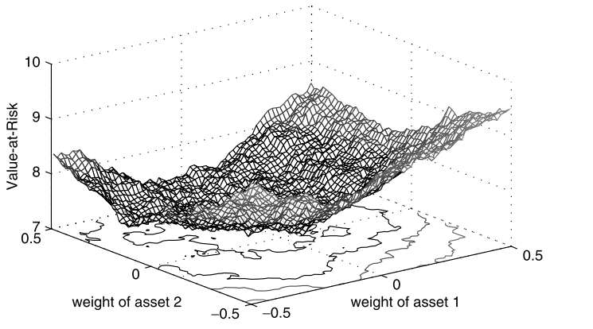
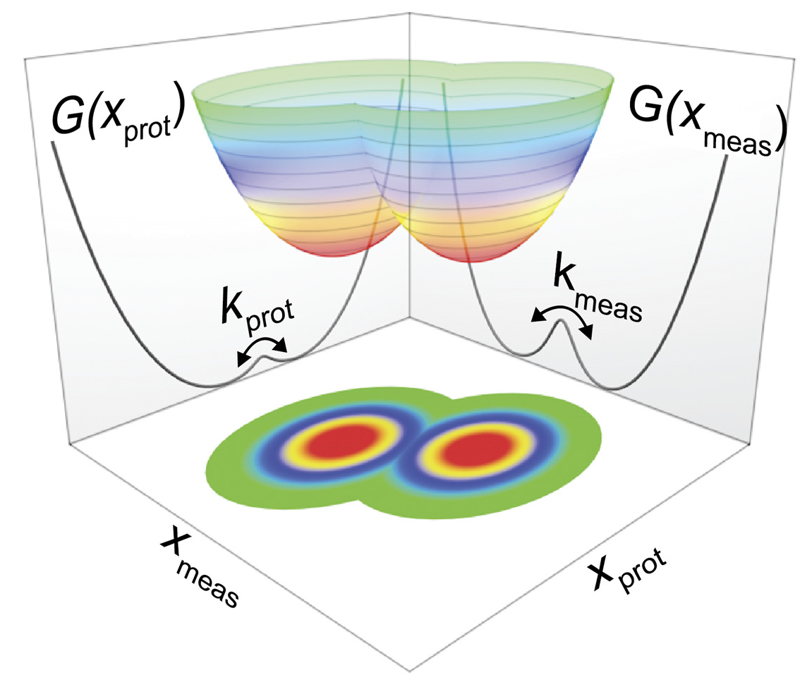
What is optimization?
Minimization of a function given a set of inputs
Applications of numerical optimization
Science/Engineering
Molecular modeling
Control systems
Finance
Portfolio optimization
Econometric models
Policy
Resource allocation
Risk models
Gilli et al. (2019)
Applications of optimization are everywhere
Edwards et al. (2020)

Slide 3
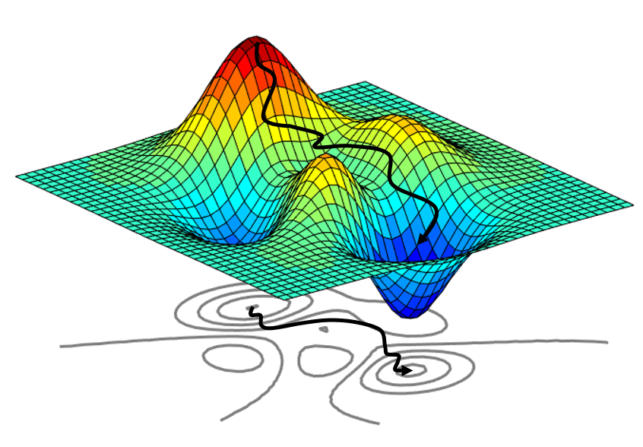
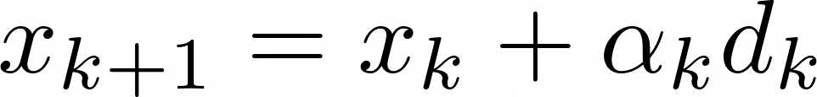


Line-search methods
Iterative method:
1. Step direction,
Determines which direction to take the step
2. Step length,
Determines how large the step should be

Slide 4
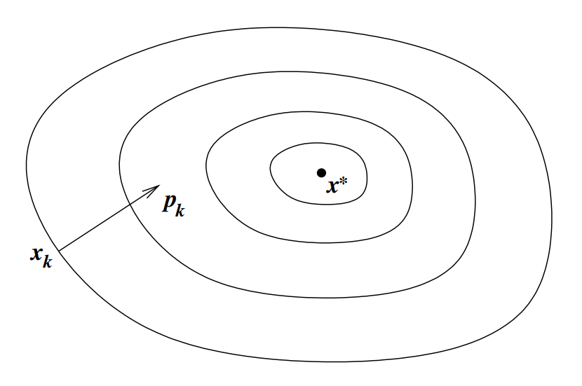
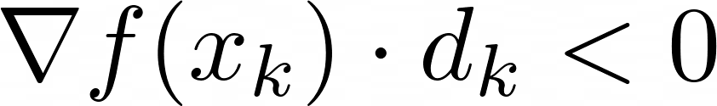
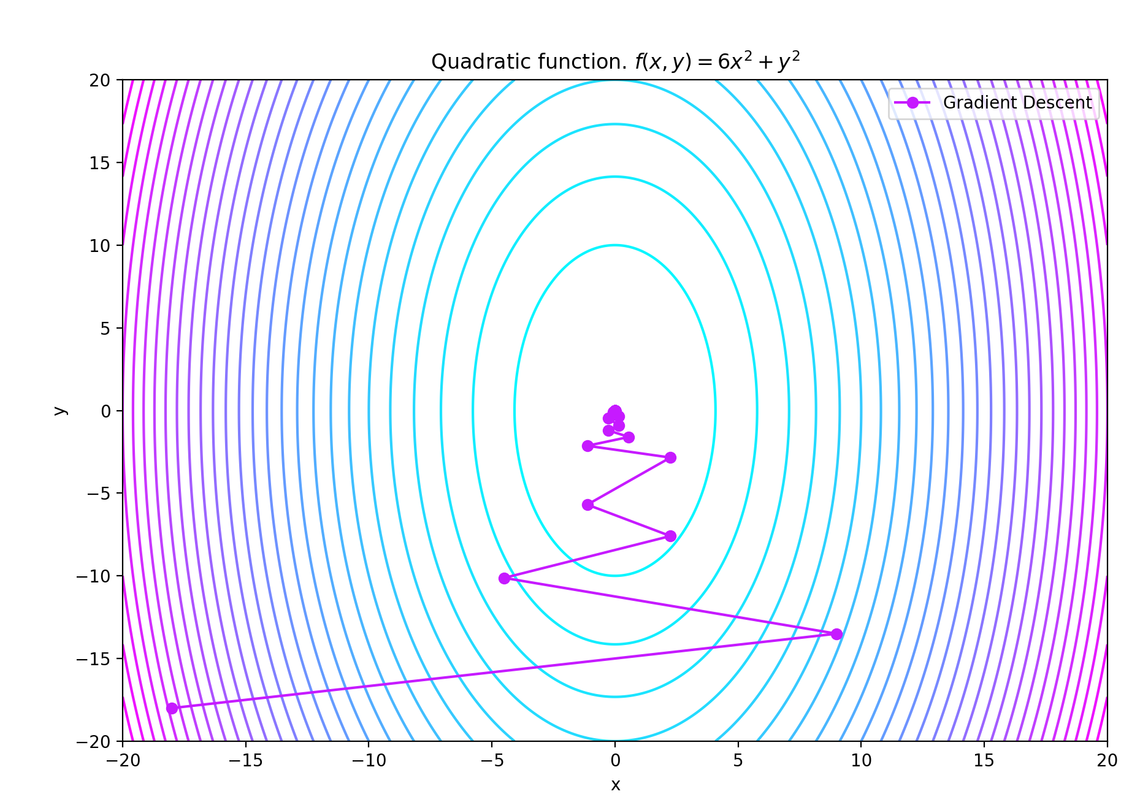
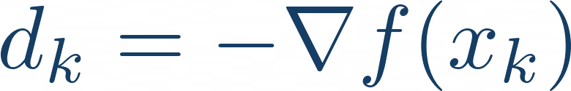
The descent direction and Steepest Descent
Descent direction:
Steepest descent is a basic optimization method
Uses the gradient as the descent direction:
Converges linearly
Step length is chosen with a backtracking line search

Slide 5
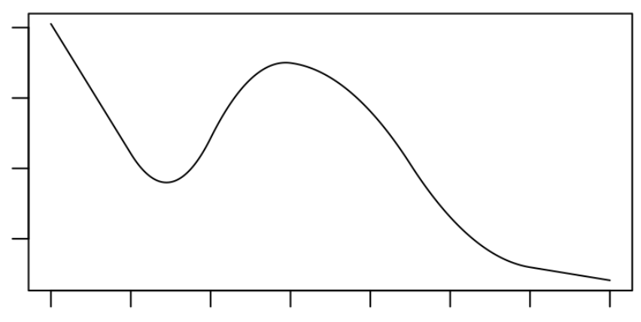
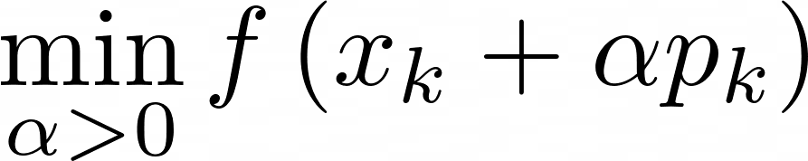
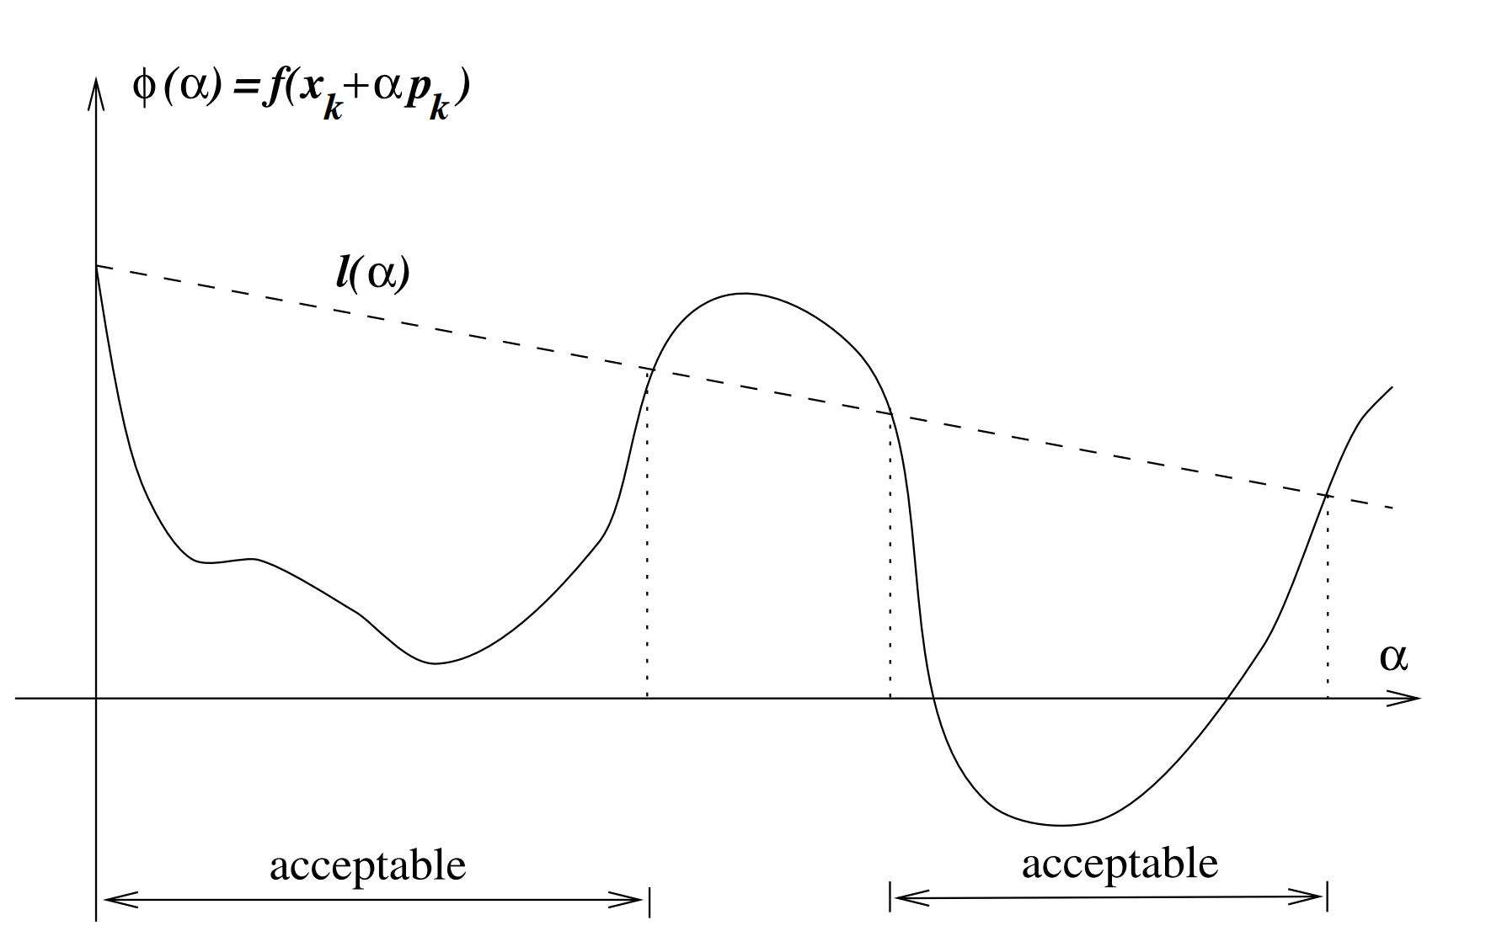
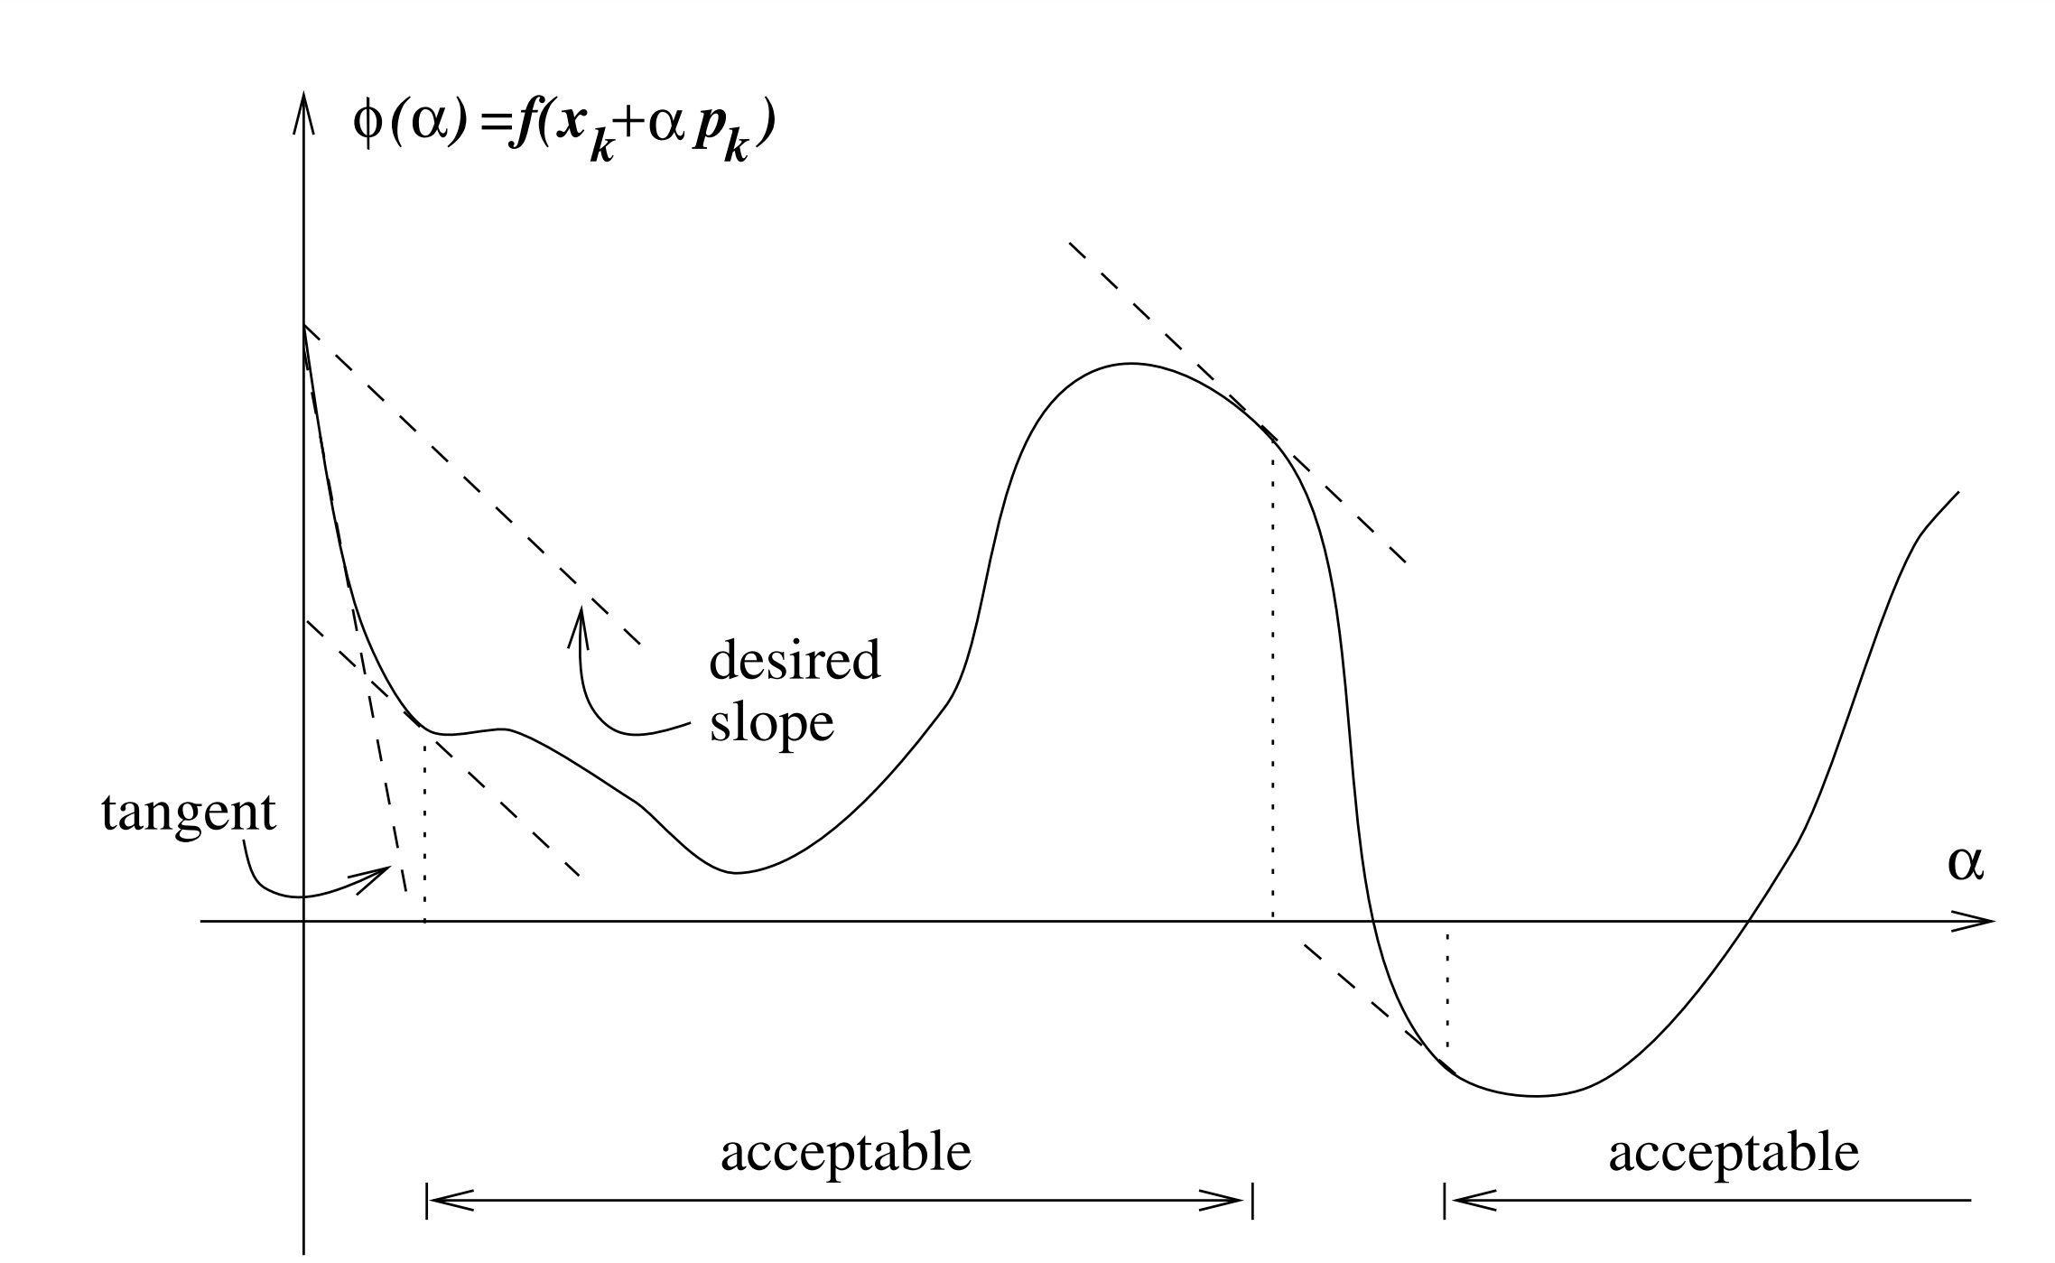
Backtracking line search to find α
Find an inexact solution to:
Sufficient decrease condition
Curvature condition
Nocedal

Slide 6
Steepest Descent

Slide 7
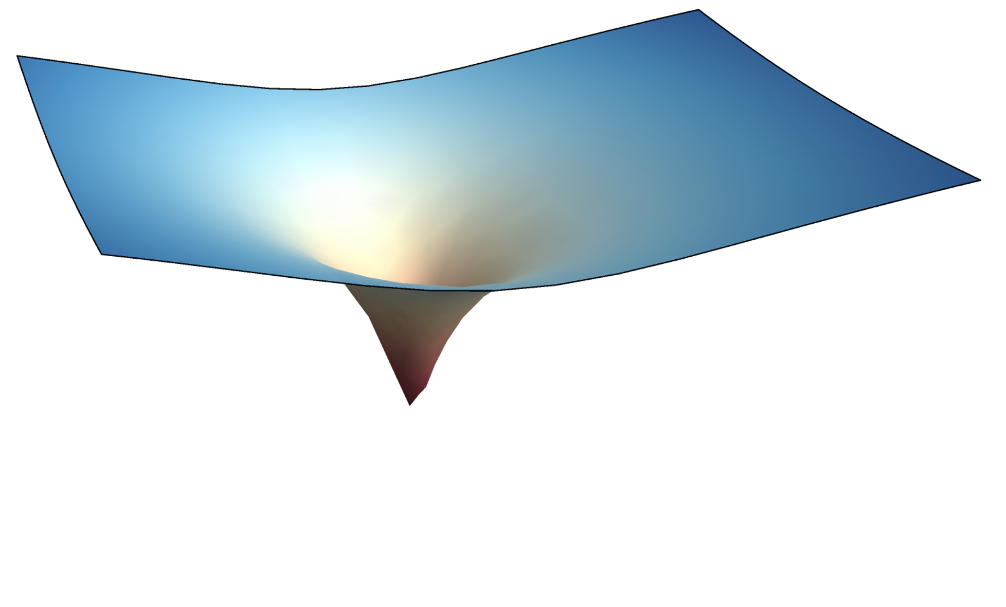
Reframing optimization as a root finding problem
Goal: find the minimum of a function
Use the fact the gradient is zero at the minimum
Can use tools developed for root finding
Newton’s method
Enables quadratic convergence
Can use quasi-Newton methods
Broyden-Fletcher-Goldfarb–Shanno (BFGS)
Lazy-Newton

Slide 8
Newton’s method for optimization
Want to find a method:
Generate an approximation of the function at a step
2. Solve the minimization problem to obtain the direction $p_{k}$
3. Newton’s method:

Slide 9
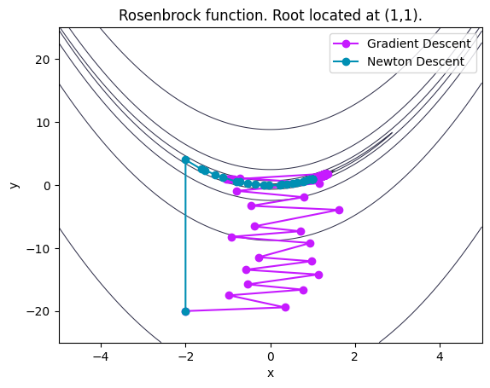
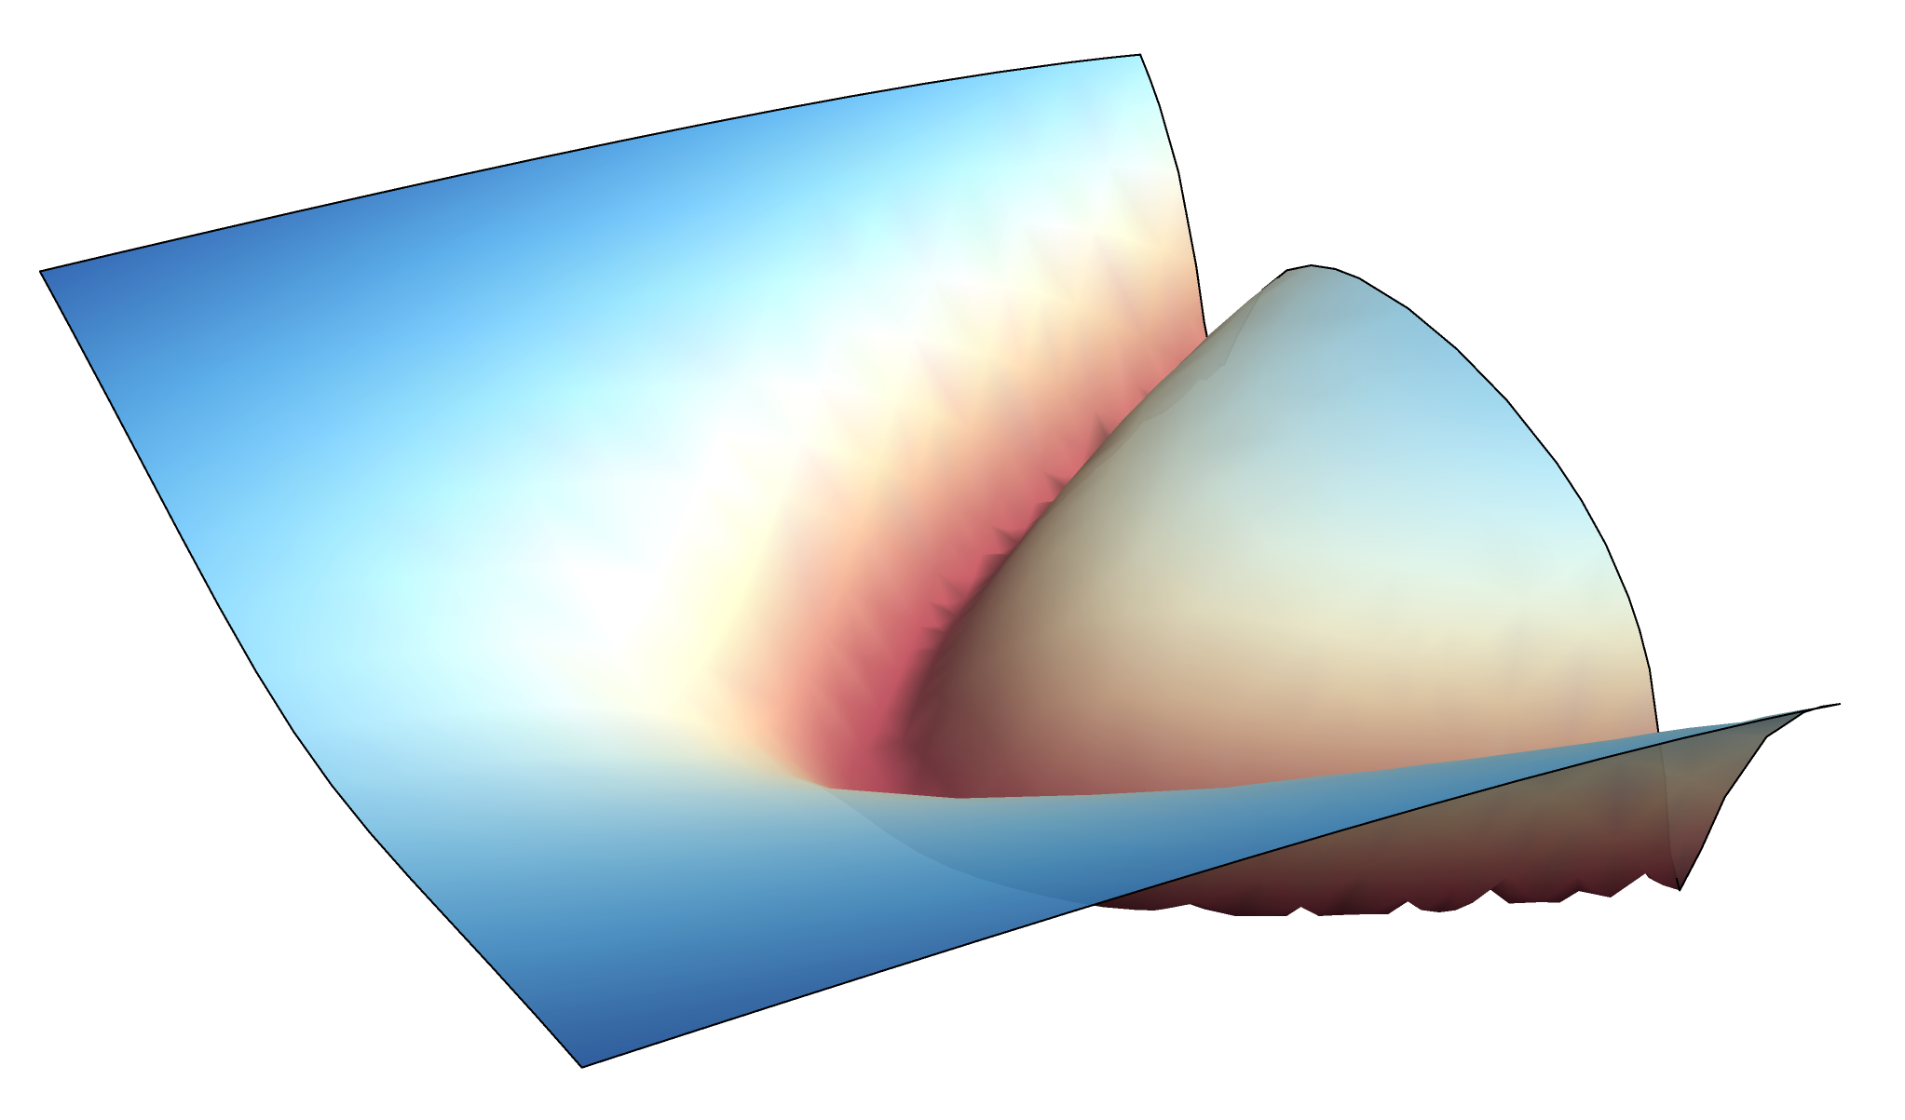
Newton’s method for optimization
Iteration:
Requirements for convergence:
The Hessian matrix must be SPD to satisfy the descent property
Initial guess must be in a region where the Hessian is SPD
Rosenbrock Function

Slide 10
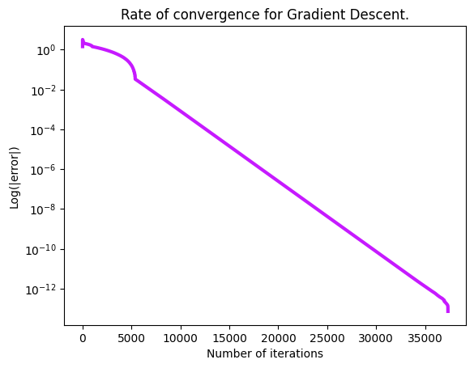
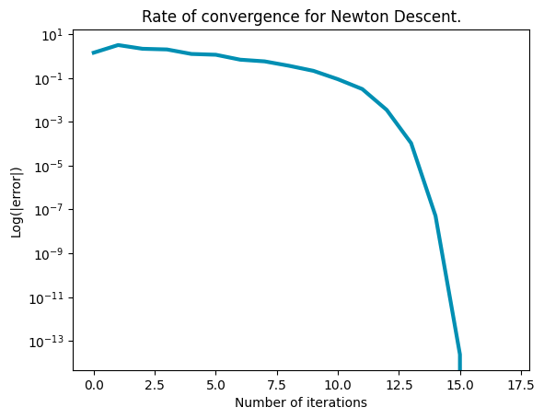
Newton’s method results in quadratic convergence
Gradient descent converged in 32,291 iterations
Newton descent converges in 16 iteration
Gradient Descent:
Newton descent:

Slide 11
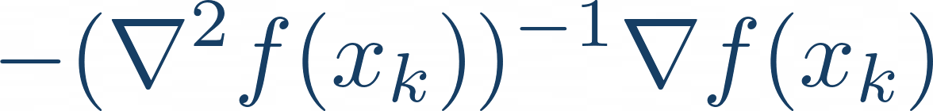
Quasi-Newton methods
Motivation:
Computing the Hessian matrix can be expensive
Solving can also be expensive
More important for higher dimensional functions
Can use quasi-Newton methods to improve algorithm
Lazy-Newton/Shaminski
Converge linearly
Broyden-Fletcher-Goldfarb–Shanno (BFGS)
Most robust/popular method
DFP Algorithm
Symmetric rank-1 update (SR1)

Slide 12
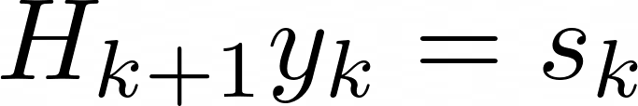
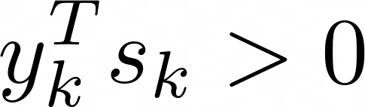
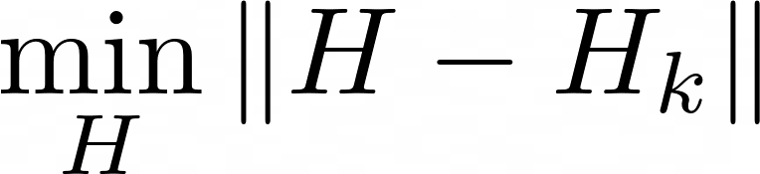
BFGS as an alternative to Newton’s method
BFGS
Secant equation:
Impose a condition to ensure the inverse Hessian approximation is SPD
Solve minimization problem to find the “closest” iteration
Benefits:
Cost per iteration is less than Newton’s method
More important for higher dimensional function

Slide 13
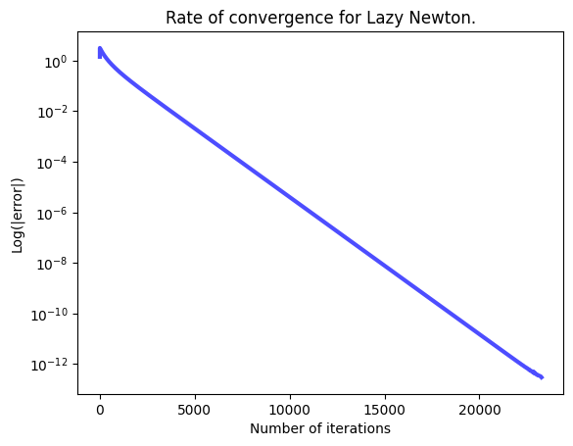
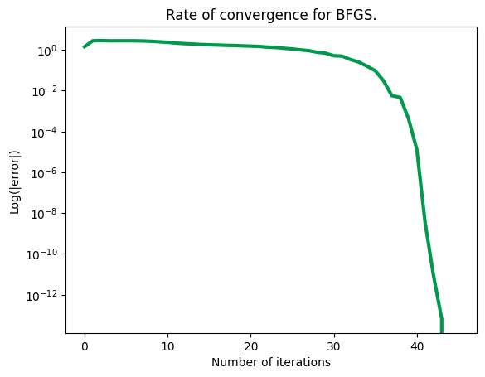
Quasi-Newton results
Lazy Newton computes the Hessian once
BFGS using the identity matrix as the initial choice of the approximate Hessian
Lazy Newton:
BFGS:

Slide 14
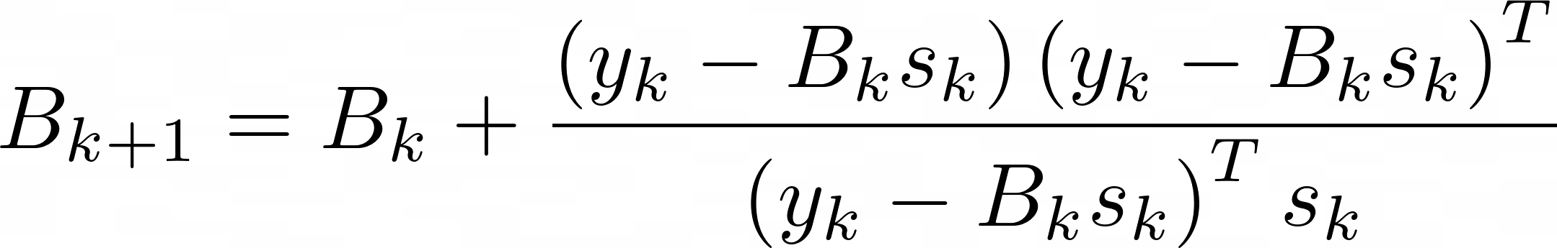
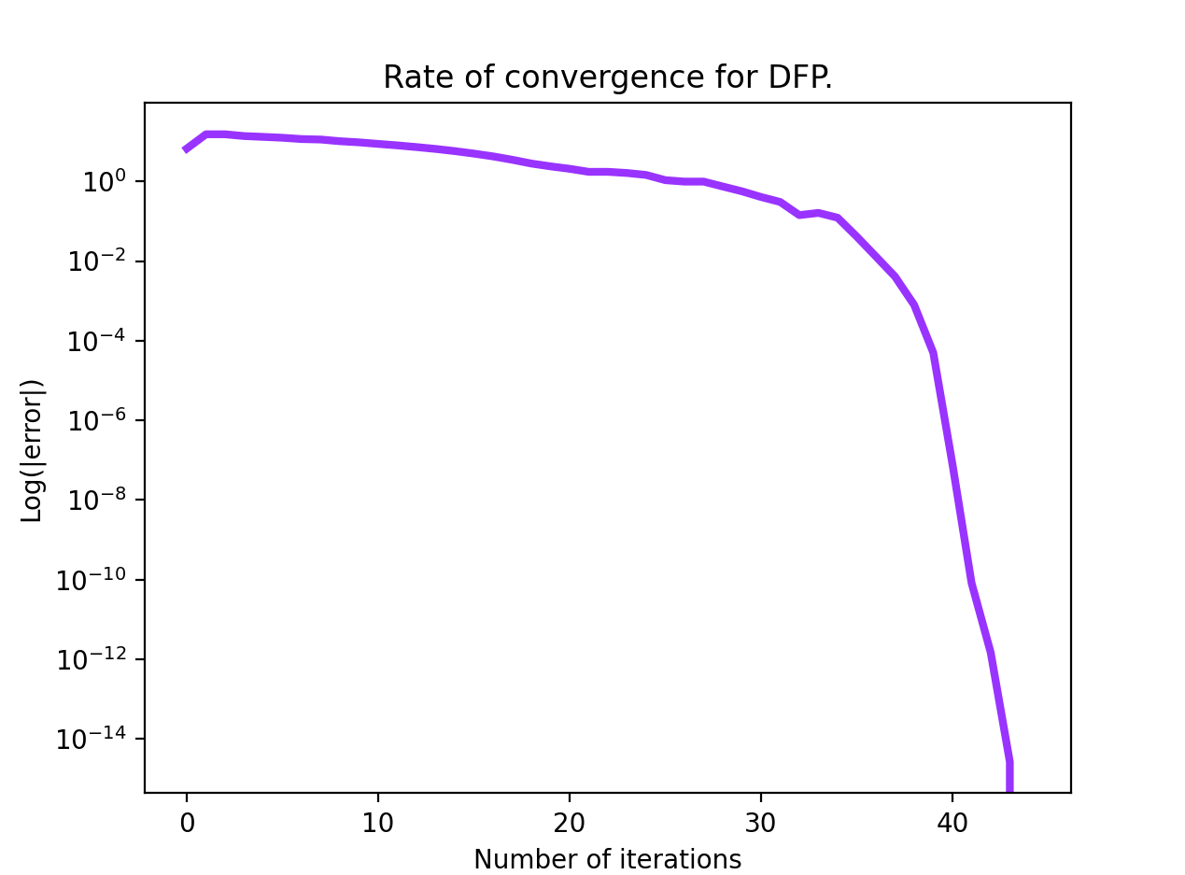
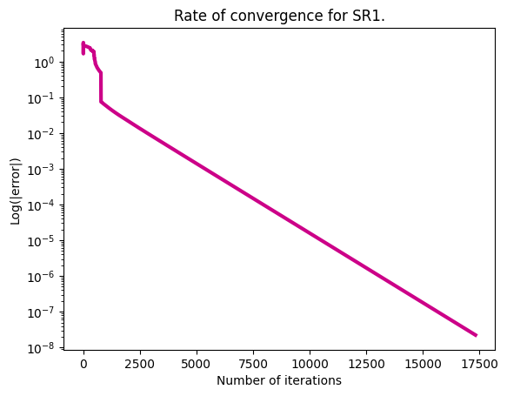
Additional quasi-Newton methods
DFP Algorithm
Symmetric rank-1 update (SR1):
Like BFGS but derived by solving the secant equation with the Hessian itself

Slide 15
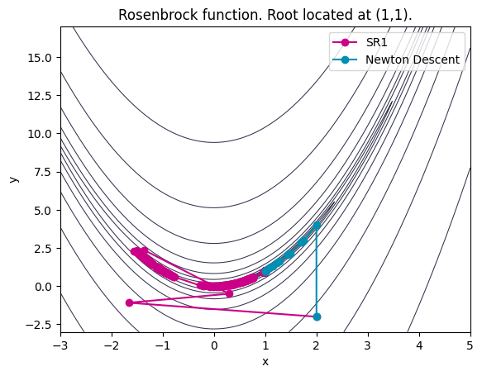
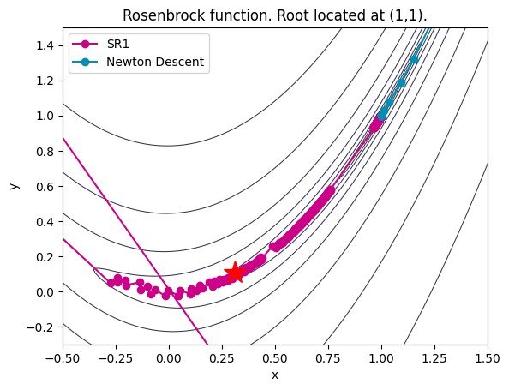
Symmetric rank-1 update (SR1):
Denominator goes to zero
There is no symmetric rank-one update that satisfies the secant equation
Behaves like Lazy Newton

Slide 16
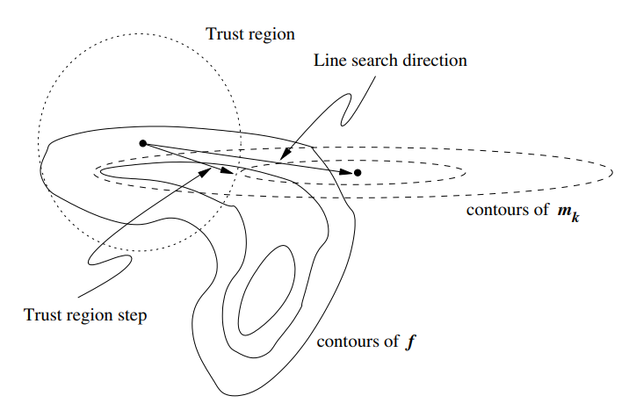

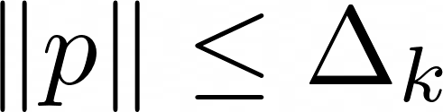
Trust region methods
Choose a maximum step length
Region we “trust” our approximation
Based on how close the approximation is to the real function
Nocedal
Minimize the model function within this region
Typically, an inexact minimization is performed
An exact approximation is overkill and too expensive for most applications
Constraint

Slide 17
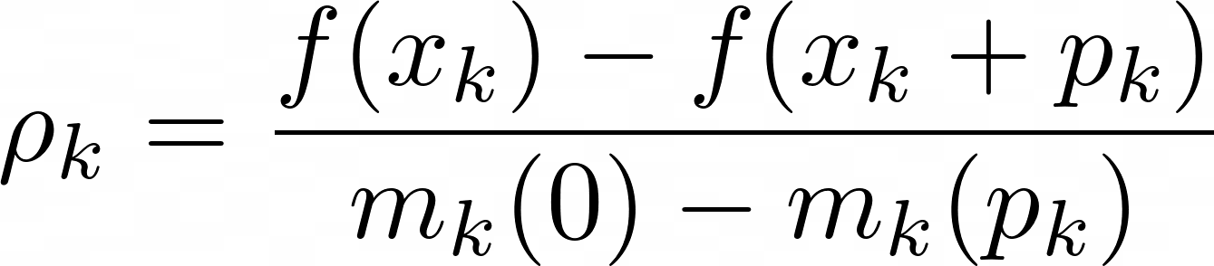
Ensure our step is within the trust region:
How do we find our trust region, $Δ_{k}$?
Nocedal
Approximately solve the minimization problem and update the iterate!
Achieved with a method like the Dogleg Method

Slide 18
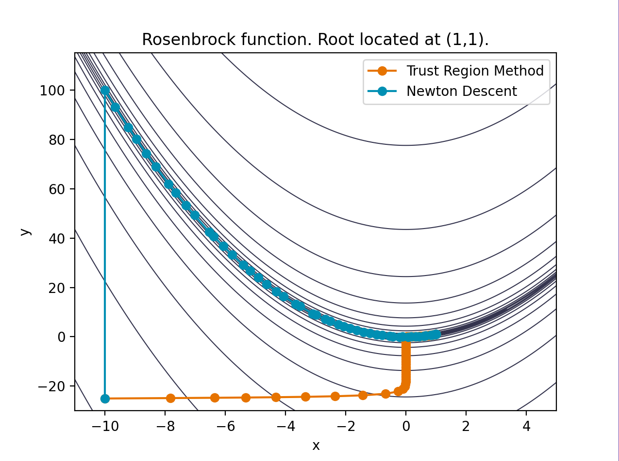
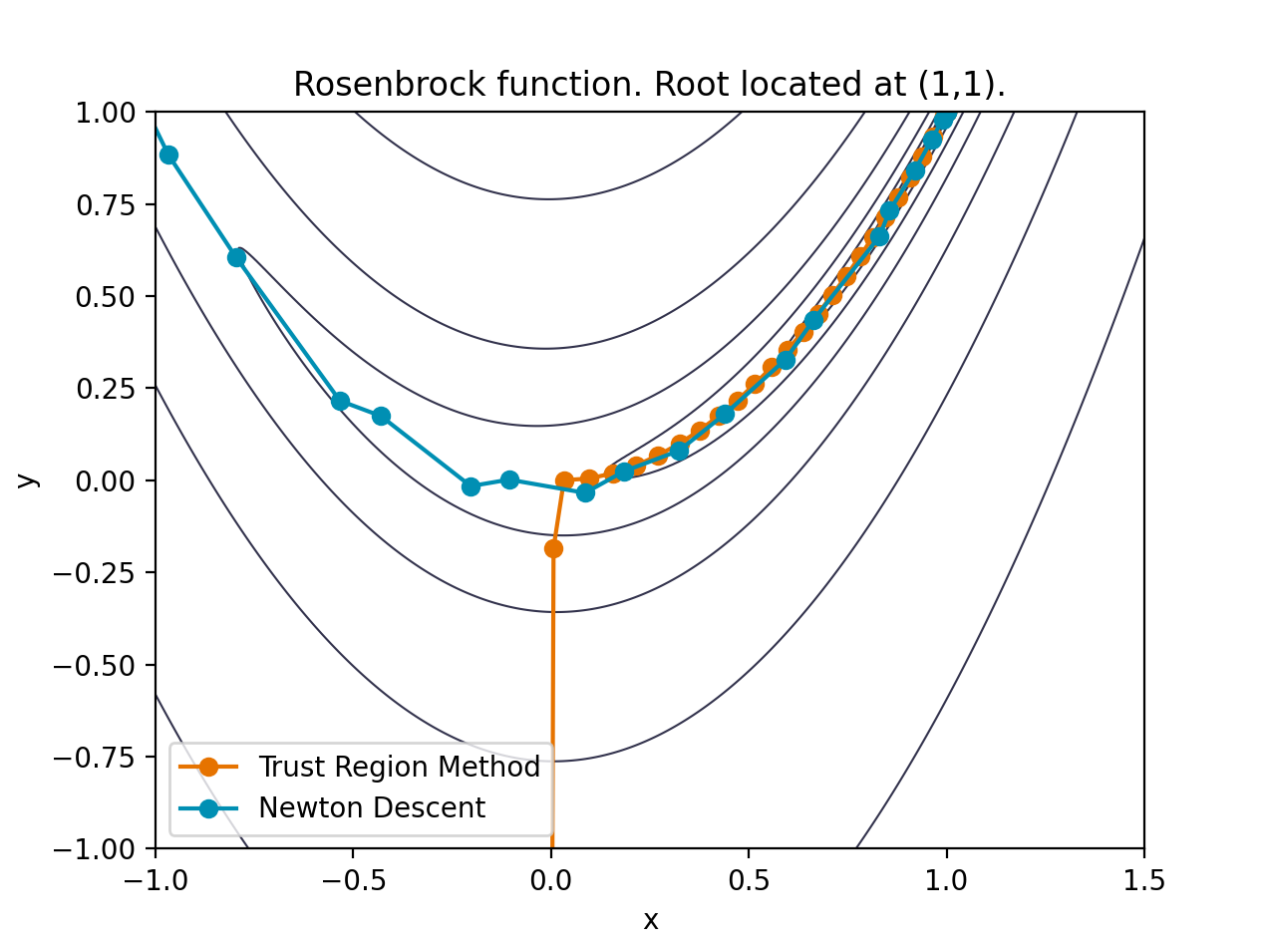
Trust region methods
TR converged in 64 iterations
Newton descent converges in 54 iteration

Slide 19
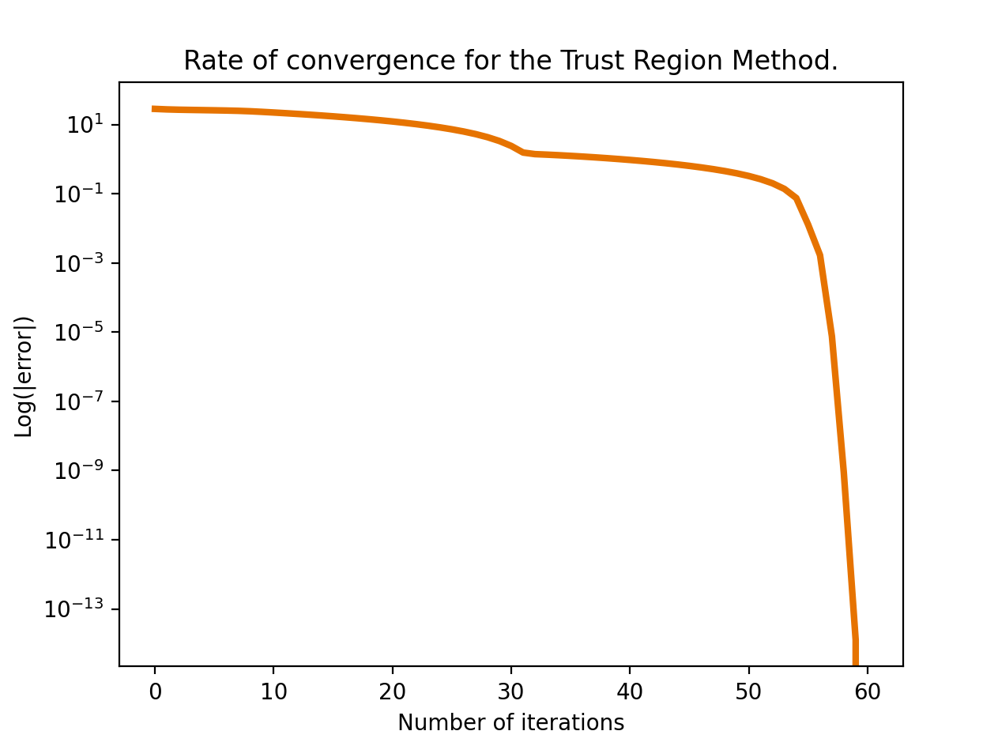
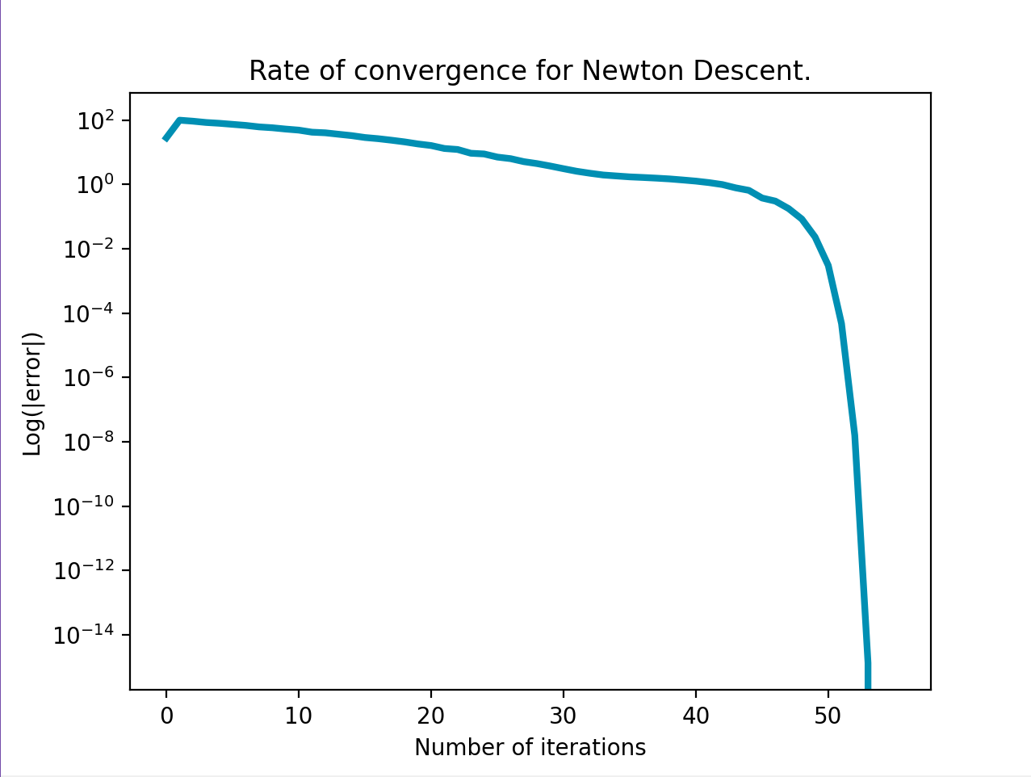
Trust region methods maintain quadratic convergence
Trust region
Newton Descent

Slide 20
Questions?

